Slide 1
Algorithms for Clustering Highly Conserved Phylogenetic Markers
Christopher Hill
Advisor: Mihai Pop
Preliminary Exam
May 15th, 2014
Notes:
No guarantees
Arbitrary cutoffs

Slide 2
TODO: Genome

Slide 3
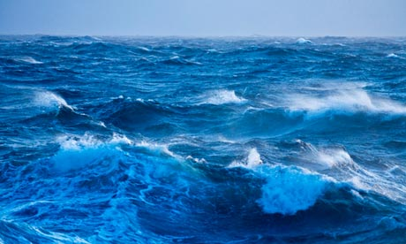
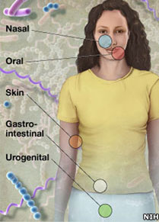
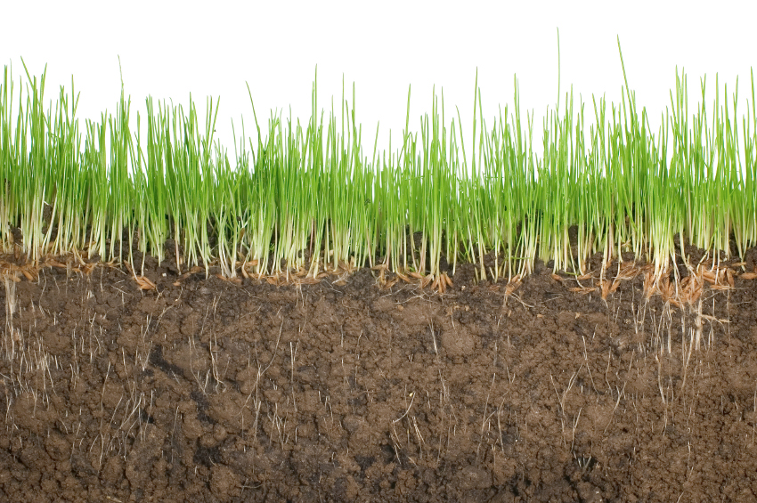
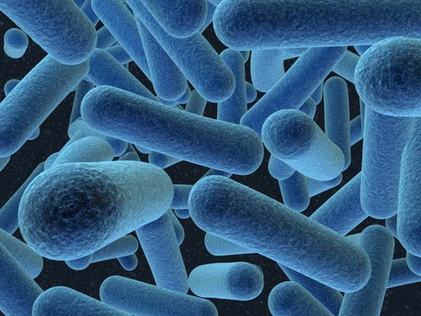
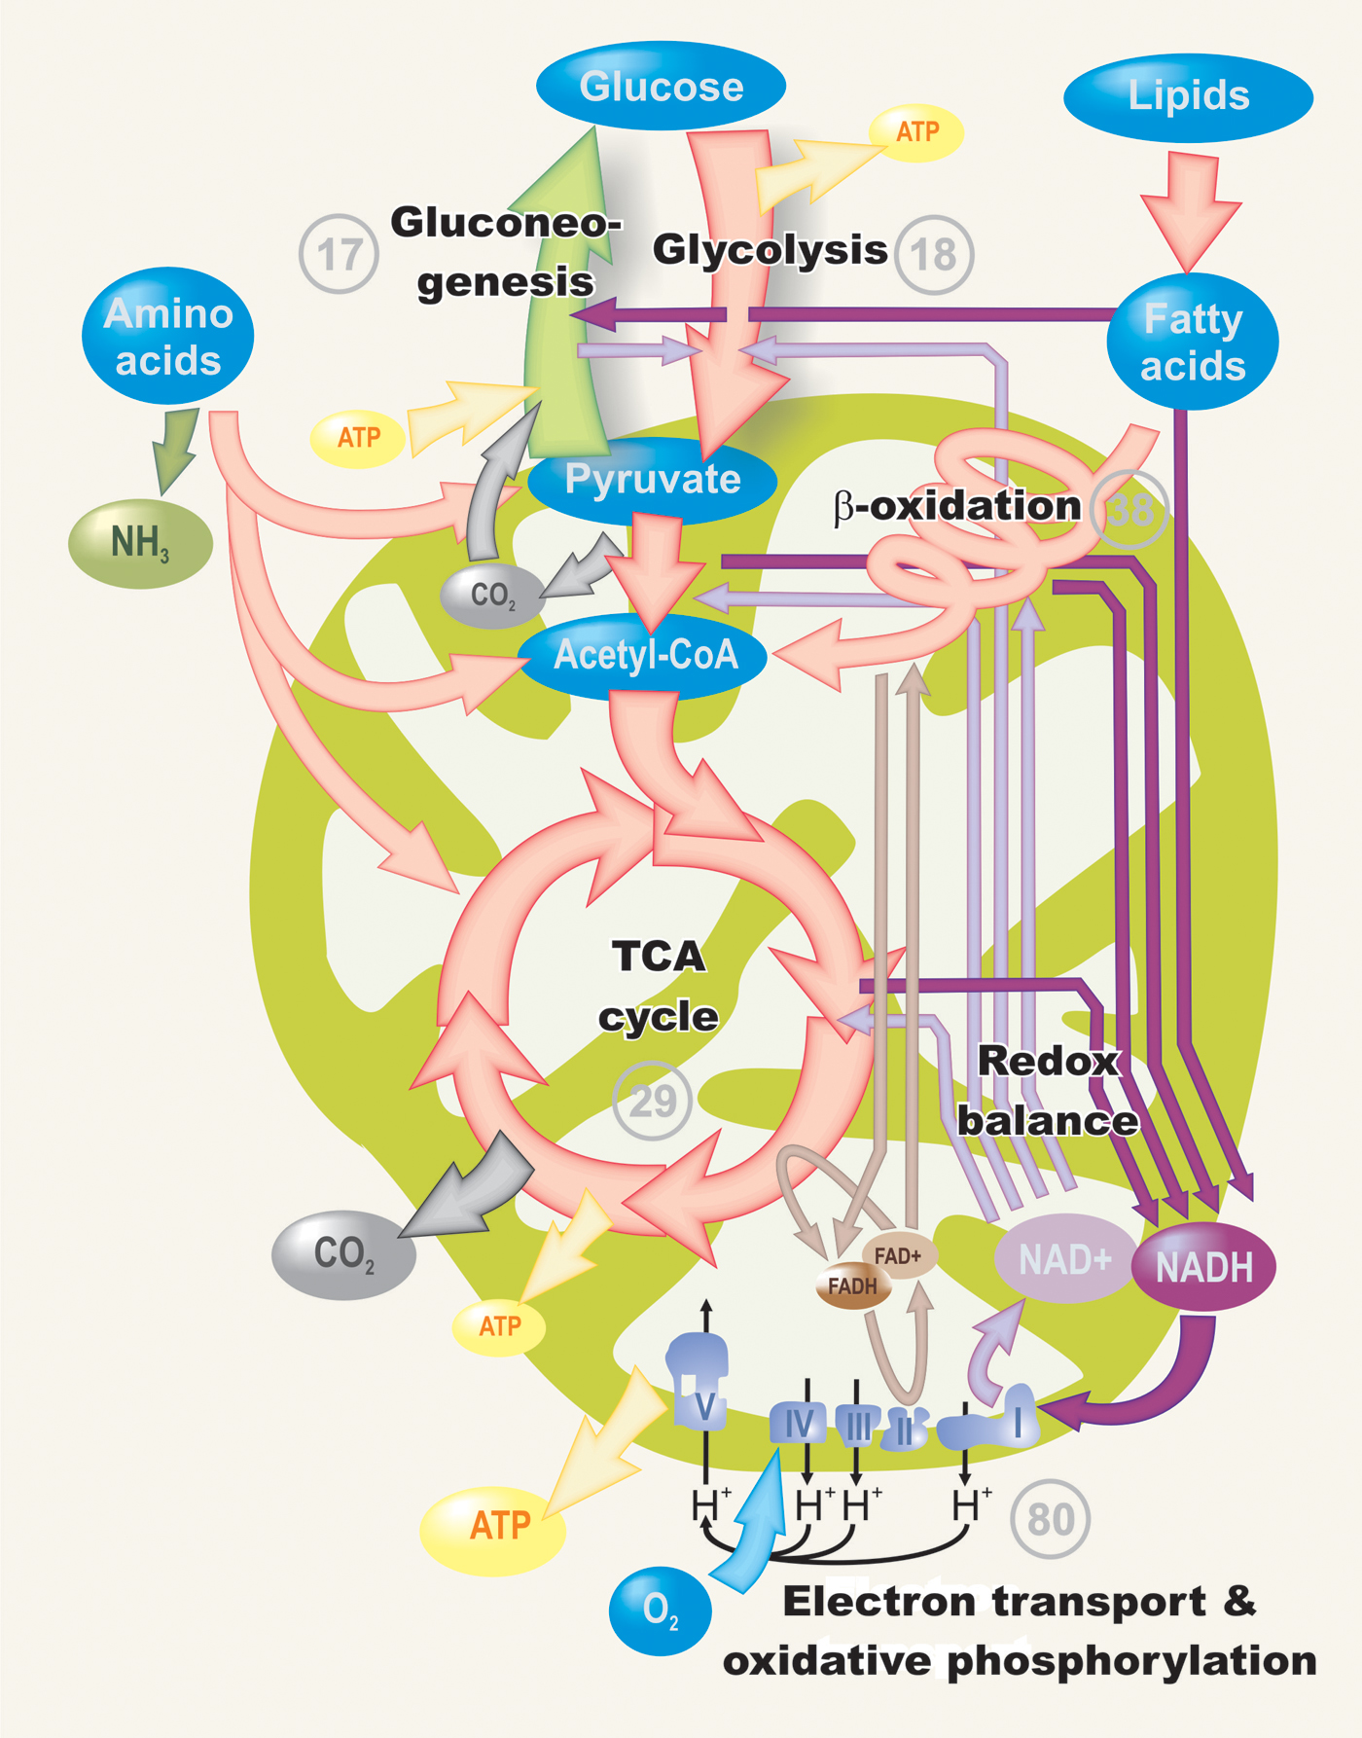
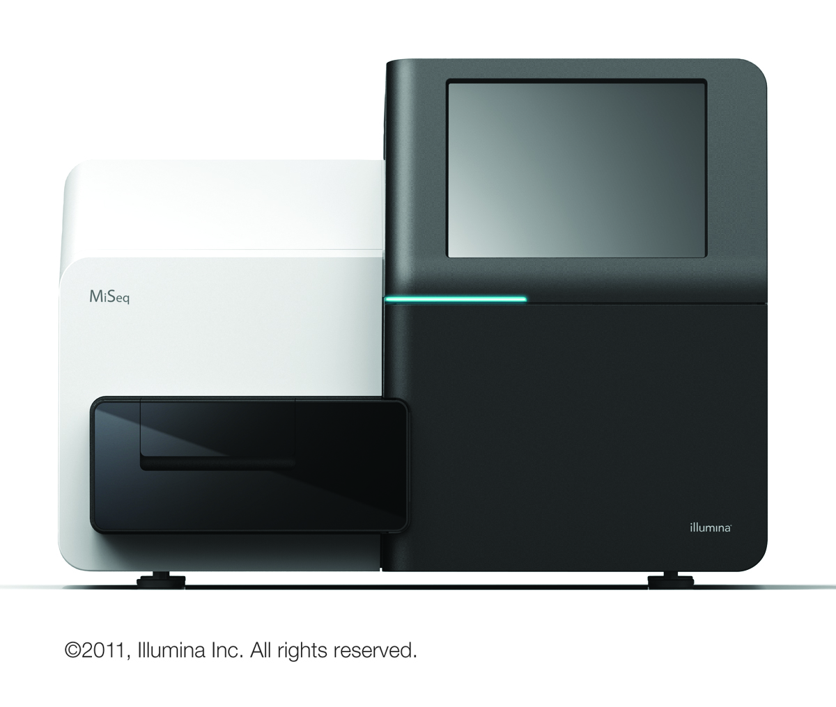
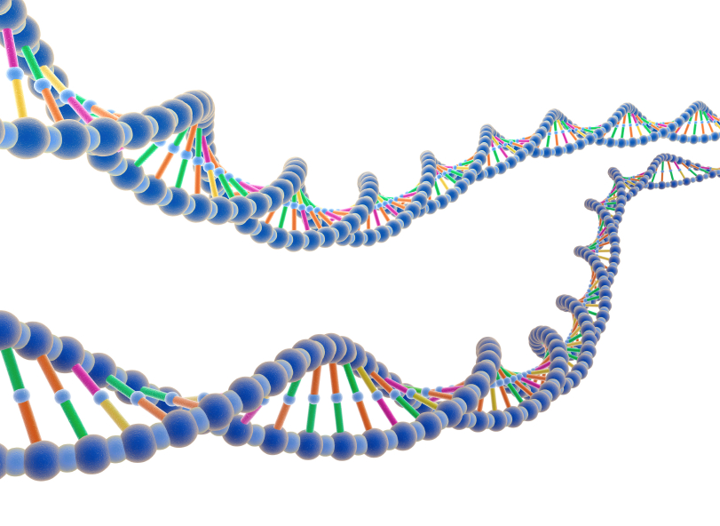
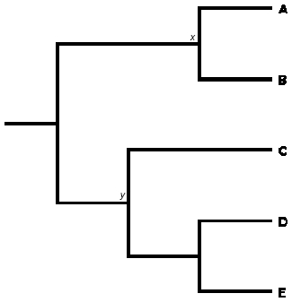
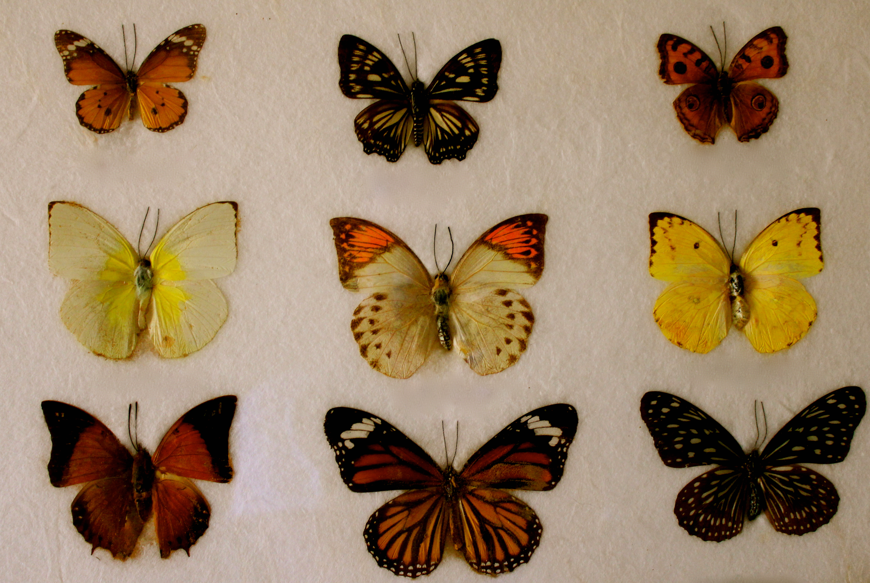
Metagenomics
http://static.guim.co.uk/sys-images/Guardian/Pix/pictures/2012/9/26/1348685373327/Southern-Ocean-010.jpg
http://news.bbcimg.co.uk/media/images/60893000/jpg/_60893806_body.jpg
http://www.randyslawnservice.com/images/grass%20and%20soil.jpg
http://blogs.discovermagazine.com/loom/2010/03/04/i-for-one-welcome-our-microbial-overlords/#.U2vcMa1dWn0
http://blogs-images.forbes.com/matthewherper/files/2011/01/Illumina_MiSeqTM_CopyRight2011.jpg
http://ingridbrowning.com/wp-content/uploads/2011/08/IMG_3658.jpg
Notes:
----- Meeting Notes (5/9/14 15:09) -----
De novo reference
How many different kinds of bacteria
Perfect world get whole sequence

Slide 4
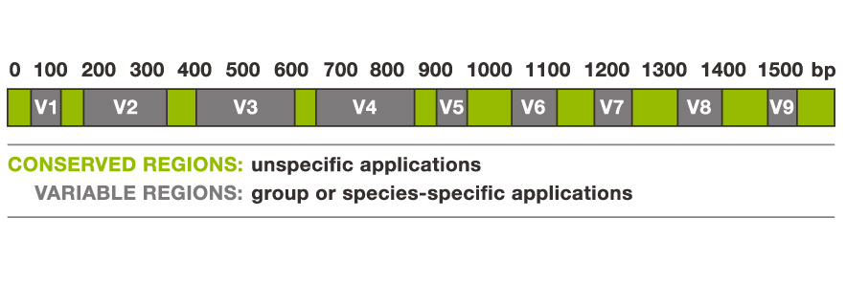
16S rRNA gene
Targeted sequencing
Whole genome shotgun sequencing
Genomic DNA
Genomic DNA
Genomic DNA
Genomic DNA
Genomic DNA
Genomic DNA
Genomic DNA
Genomic DNA
Sequencing Error
http://www.alimetrics.net/en/images/stories/content/M_00-06%20DNA%20based%20kuva%203.jpg
Notes:
Green genes, silva
----- Meeting Notes (5/9/14 15:09) -----
Which regions we attend to use.
Characterize variable regions
Ill change the picture
V1-V3, V3-V5

Slide 5
Sequencing Error
Species-specific SNP

Slide 6
16S
16S
16S
…
16S
16S
16S
16S
16S
16S
16S
16S
16S
16S
16S
16S
16S
16S
16S
16S
16S
16S
16S
16S rRNA targeted sequencing
Whole genome shotgun (WGS)
sequencing
Notes:
----- Meeting Notes (5/9/14 15:09) -----
Coverage can't assemble
Objective,

Slide 7
TODO: Goal
Millions of sequences
Super fast de novo clustering

Slide 8
Clustering
Notes:
----- Meeting Notes (5/9/14 15:09) -----
Population, clustering differences, why cluster 16s

Slide 9
Hierarchical
Divisive
(Top-down)
Agglomerative
(Bottom-up)
Often O(n³) work, but more efficient algorithms exist.
Notes:
----- Meeting Notes (5/9/14 15:09) -----
Three different shapes

Slide 10
Greedy
1. Select a cluster center.
3. Repeat until no more
sequences remain.
2. Recruit sequences to center.

Slide 11
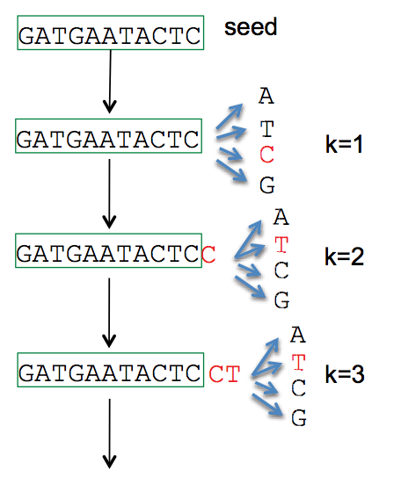
1. Select a cluster center.
Length | Abundance | k-mers
Longest remaining sequence
Run fast deduplication
…
CD-HIT (Li et al. 2006)
UCLUST (Edgar 2010) DNACLUST (Ghodsi et al. 2011)
UCLUST (Edgar 2010)
AbundantOTU (Ye 2010)

Slide 12
2. Recruit sequences to center.
Edit distance
Similarity
ATGTGA
x|||x|
-TGTCA
Substitutions, insertions, deletions
K-mer distance
k=2 AA AC AG AT .. TG TT
ATGTCA: [0 0 0 1 .. 2 0]
TGTCA: [0 0 0 0 .. 1 0]
Notes:
Fractional common k-mer count: For the last measure, the distance is computed based on the minimum count of every k-mer in the two sequences, thus if two sequences are very different, the minimums will all be small.
Identiy
----- Meeting Notes (5/9/14 15:09) -----
Characters
TGTG - 2
Add gap character
Distances
challenges

Slide 13
How to calculate edit distance between:
AGGTATCGC and ATGGC?
Problem
Dynamic programming
Solution

Slide 14
Break down problem into easier sub-problems
Dynamic Programming
M(n,m) – Table storing solutions to sub-problems for aligning text and the pattern of lengths n and m, respectively.
M(i,j) – minimum edit distance of aligning text_{1..i} to pattern_{1..j}
Compute M(i,j) using previously computed smaller values
Notes:
----- Meeting Notes (5/9/14 15:09) -----
Subproblems have a specific set
Recursively

Slide 15
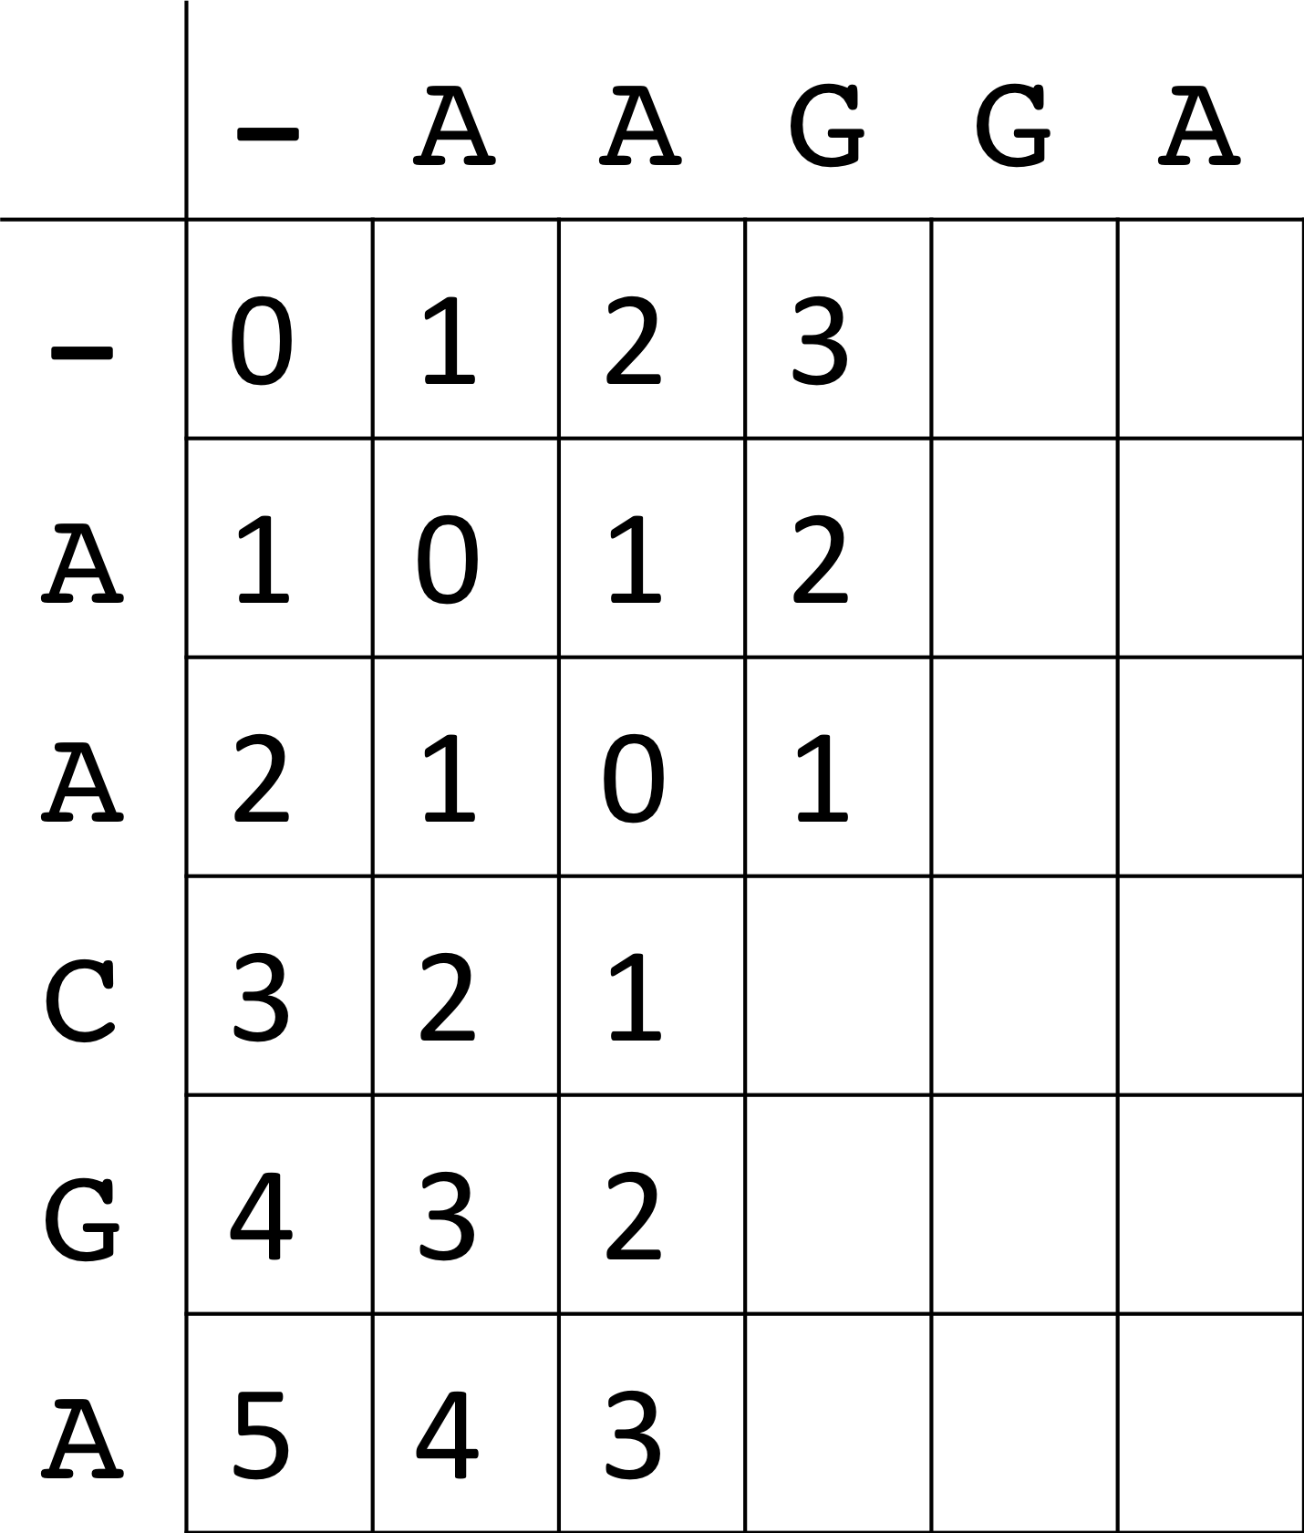
d
q
Optimal edit distance will
be located M_{ij}
O(n*m) work and memory
Notes:
----- Meeting Notes (5/9/14 15:09) -----
levenstein distance
M_nm

Slide 16
Global alignment
Semi-global alignment
 |  | 0 | 1 | 2 | 3 | 4 | 5 | 6 | 7 | 8 | 9
 | M | - | A | G | G | T | A | T | C | G | C
0 | - | 0 | 1 | 2 | 3 | 4 | 5 | 6 | 7 | 8 | 9
1 | A | 1 | 0 | 1 | 2 | 3 | 4 | 5 | 6 | 7 | 8
2 | T | 2 | 1 | 1 | 2 | 2 | 3 | 4 | 5 | 6 | 7
3 | G | 3 | 2 | 1 | 1 | 2 | 3 | 4 | 5 | 5 | 6
4 | G | 4 | 3 | 2 | 1 | 2 | 3 | 4 | 5 | 5 | 6
5 | C | 5 | 4 | 3 | 2 | 2 | 3 | 4 | 4 | 5 | 5
 |  | 0 | 1 | 2 | 3 | 4 | 5 | 6 | 7 | 8 | 9
 | M | - | A | G | G | T | A | T | C | G | C
0 | - | 0 | 0 | 0 | 0 | 0 | 0 | 0 | 0 | 0 | 0
1 | A | 1 | 0 | 1 | 1 | 1 | 0 | 1 | 1 | 1 | 1
2 | T | 2 | 1 | 1 | 2 | 1 | 1 | 0 | 1 | 2 | 2
3 | G | 3 | 2 | 1 | 1 | 2 | 2 | 1 | 1 | 1 | 2
4 | G | 4 | 3 | 2 | 1 | 2 | 3 | 2 | 2 | 1 | 2
5 | C | 5 | 4 | 3 | 2 | 2 | 3 | 3 | 2 | 2 | 1
A-GGTATCGC
ATGGC-----
AGGTATCGC
ATGGC
Notes:
----- Meeting Notes (5/9/14 15:09) -----
highly conservative markers - 16s

Slide 17
What if we want to limit the amount of edits?
For example, k = 2?
Global alignment
Semi-global alignment
 |  | 0 | 1 | 2 | 3 | 4 | 5 | 6 | 7 | 8 | 9
 | M | - | A | G | G | T | A | T | C | G | C
0 | - | 0 | 1 | 2 | 3 | 4 | 5 | 6 | 7 | 8 | 9
1 | A | 1 | 0 | 1 | 2 | 3 | 4 | 5 | 6 | 7 | 8
2 | T | 2 | 1 | 1 | 2 | 2 | 3 | 4 | 5 | 6 | 7
3 | G | 3 | 2 | 1 | 1 | 2 | 3 | 4 | 5 | 5 | 6
4 | G | 4 | 3 | 2 | 1 | 2 | 3 | 4 | 5 | 5 | 6
5 | C | 5 | 4 | 3 | 2 | 2 | 3 | 4 | 4 | 5 | 5
 |  | 0 | 1 | 2 | 3 | 4 | 5 | 6 | 7 | 8 | 9
 | M | - | A | G | G | T | A | T | C | G | C
0 | - | 0 | 0 | 0 | 0 | 0 | 0 | 0 | 0 | 0 | 0
1 | A | 1 | 0 | 1 | 1 | 1 | 0 | 1 | 1 | 1 | 1
2 | T | 2 | 1 | 1 | 2 | 1 | 1 | 0 | 1 | 2 | 2
3 | G | 3 | 2 | 1 | 1 | 2 | 2 | 1 | 1 | 1 | 2
4 | G | 4 | 3 | 2 | 1 | 2 | 3 | 2 | 2 | 1 | 2
5 | C | 5 | 4 | 3 | 2 | 2 | 3 | 3 | 2 | 2 | 1
O(k*m) work and memory
O(n*m) work and memory!
Notes:
----- Meeting Notes (5/9/14 15:09) -----
Philosophical, time

Slide 18
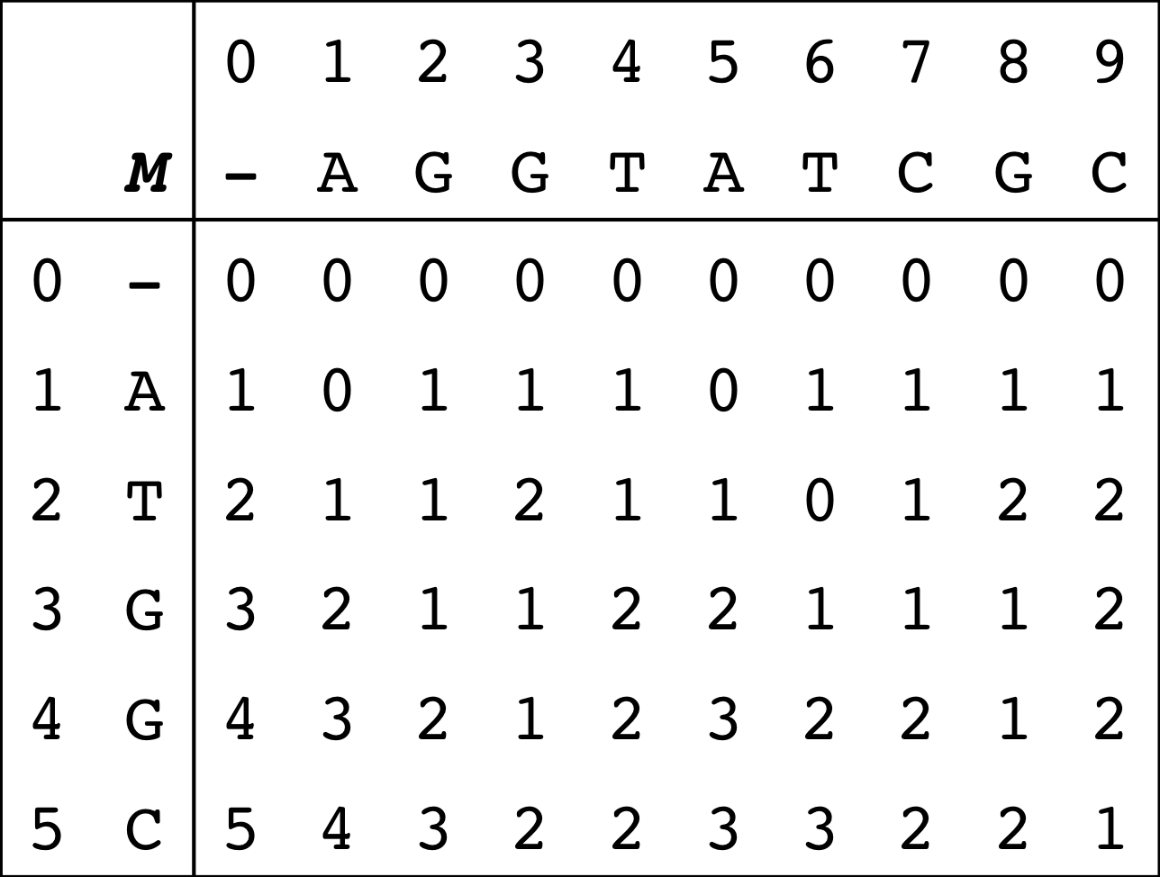
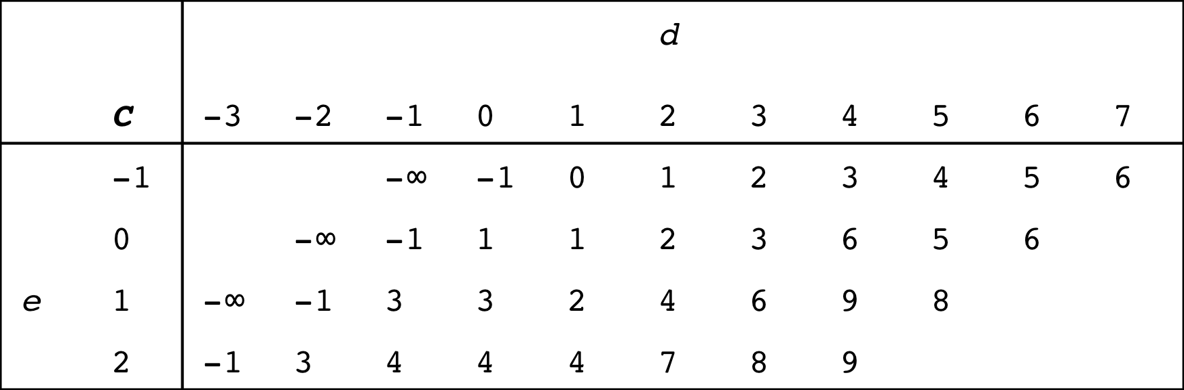
Traditional dynamic programming table
Semi-global alignment
Alternate dynamic programming table
C(e,d) = last column in M on d-diagonal that contains e edits.
C(1,2) = 1
d = 2
O(k*m) work*
and memory!
Notes:
----- Meeting Notes (5/9/14 15:09) -----
red square wrong
edit distance
c(1,2) = 4

Slide 19
TODO: Farthest reaching d-path
Explain Landau-Vishkin algorithm
How to fill out the matrix

Slide 20
TODO: Preliminary Results
Dataset:
1,000 randomly chosen 16S rRNA sequences from HMP (600-300bp)
Center:
Randomly 637bp sequence
 | Semi-global (k=5)
Naïve | 1.022 sec
Landau-Vishkin | 0.040 sec
Speedup | 25.599x
Runtimes averaged over 100 runs.

Slide 21
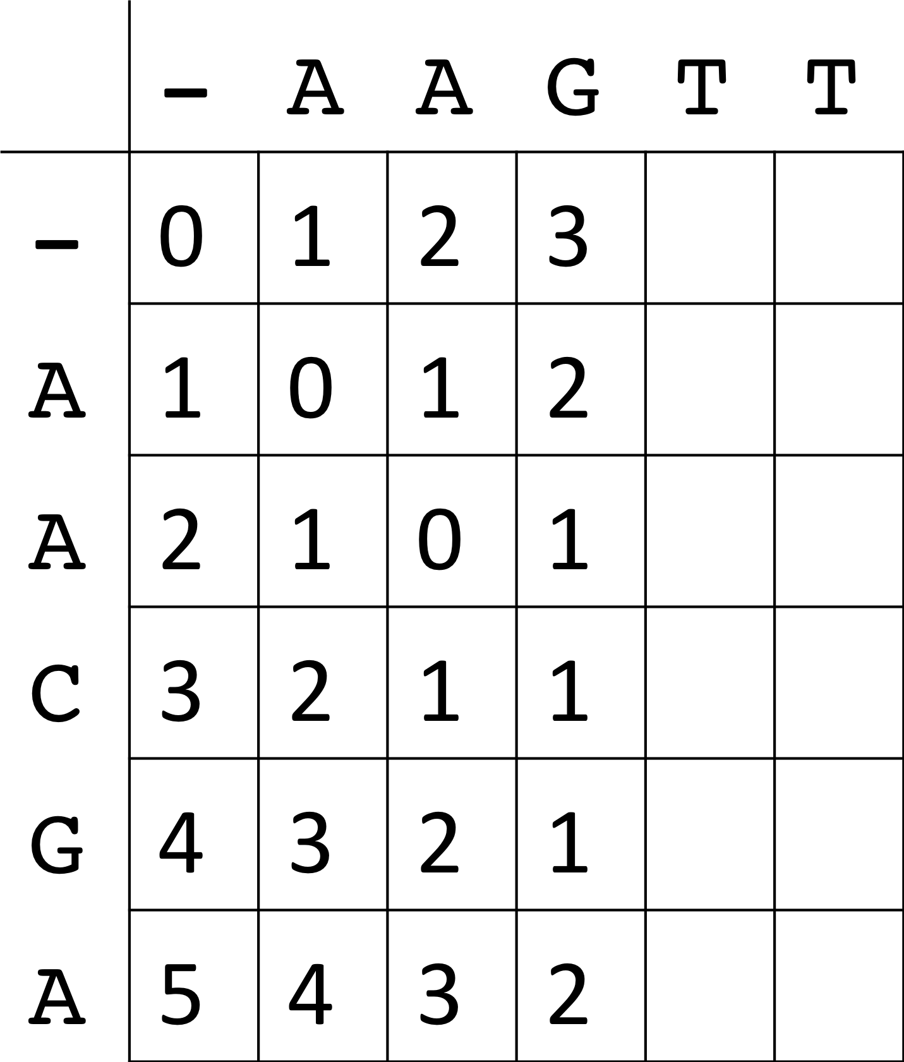
d1
d2
q
q
In DNACLUST, sequences are stored sorted so we can reuse parts from the previous dynamic programming table.

Slide 22
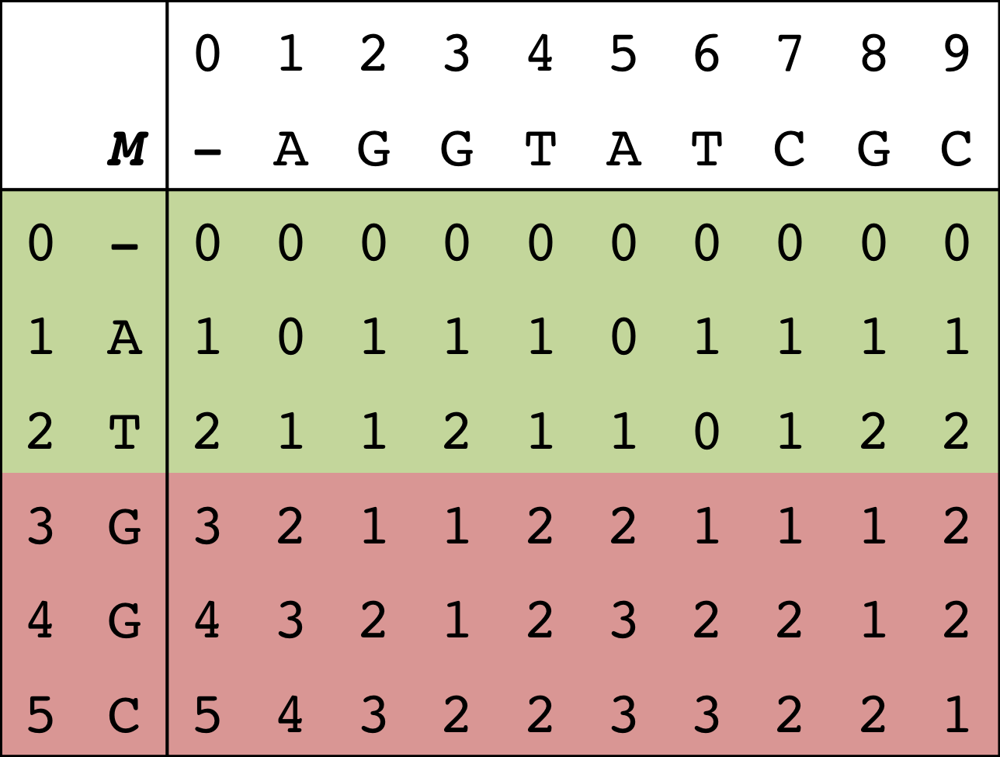
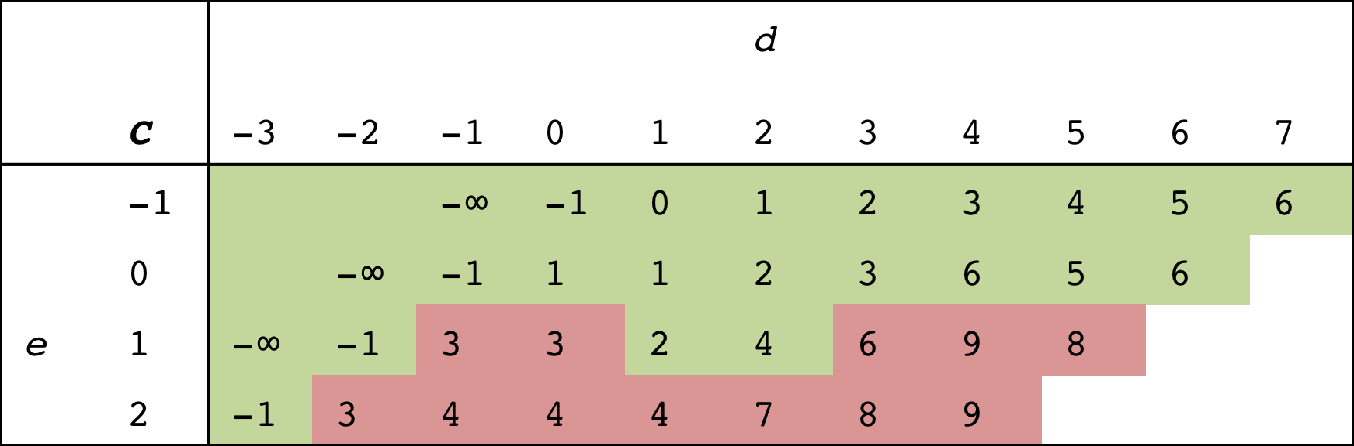
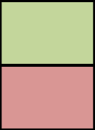
How do we exploit this property in the alternative representation?
Previous sequence: ATGGC
New sequence: ATTAA
LCP: 2
Traditional dynamic programming table
Can reuse
Need to recompute
Alternate dynamic programming table

Slide 23
Notes:
----- Meeting Notes (5/9/14 15:09) -----
Put formula in there

Slide 25
Notes:
----- Meeting Notes (5/9/14 15:09) -----
Put proof

Slide 26
O(k + n) work to reuse previous matrix.

Slide 27
Parallelization

Slide 28

Parallelization
CATGCTGCCTCCCGTAGGAGGTGGGCTTCCTC
Pick a cluster center
CATGCTGCCTC..GCTTCCTC
CATGTTGCCTC..GCTTCCTC
CATGTTGCCTC..GCTTCCTC
CATTTTGCCTC..GCTTTTTC
CATTTTGCCTC..GCTTTTTC
CATTTTGCCTC..GCTTTTTC
CATGTTGCCTC..GCTTCCTC
CCTGTTGCCTC..GCTTCCTC
CCTGTTGCCTC..GCTTCCTC
CCTGTTGCCTC..GCTTCCTC
CCTGTTGCCTC..GCTTCCTC
CCTGTTGCCTC..GCTTCCTC
Recruit to cluster center
Recruit to cluster center
http://www.clker.com/cliparts/4/b/8/d/1194983813750083554server_mimooh_.svg.hi.png
Notes:
First thing I added was support for multiple cores.
We can parallelize the recruit to cluster center

Slide 29
Notes:
Quasi-linear speedup.
1.5x faster when doubling the threads
Second half of the talk, I’ll touch briefly on what data structures uses dnaclust to align the data

Slide 30
AGGT
????
ATGG
M(i,j) =
AGG
|x|
ATG
M(i-1,j) =
AGG
ATG
M(i,j-1) =
AGG
ATG
M(i-1,j-1) =

Slide 31
Ambiguous assignments

Slide 32
Hidden

Slide 33
Thanks
TBA

